Slide 1


Docking assays of Musashi-1 allosteric RNA-binding sites
Author: Lucas Goiriz Beltrán (UPV - CSIC)
Supervisor: Dr. Emmanuel Fajardo (UOC)
January 2023

Slide 2
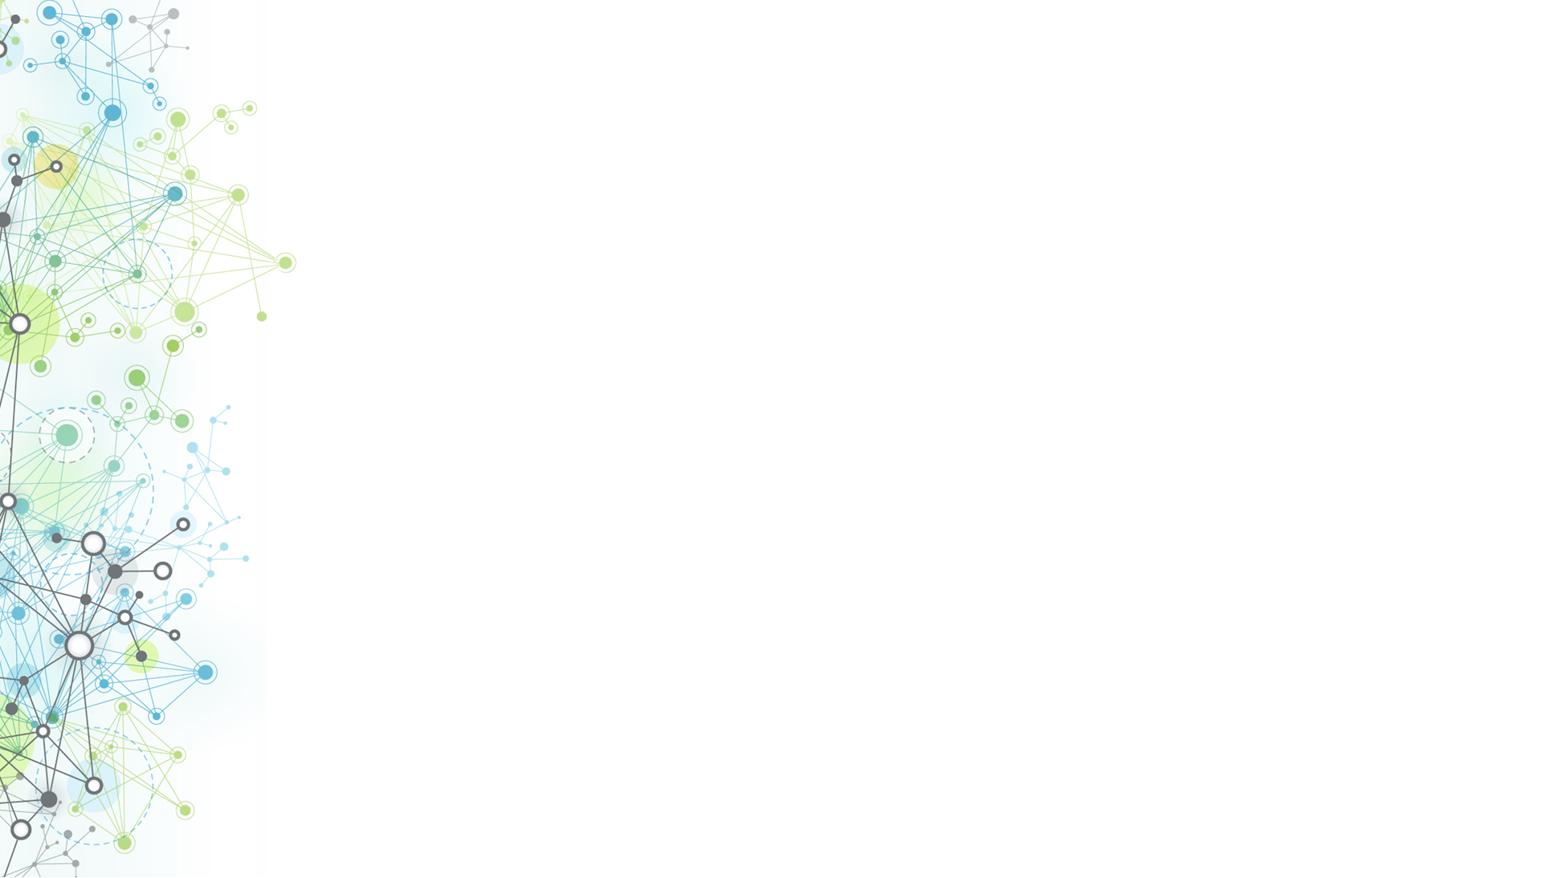
Index
Introduction
Objectives
Generation of 3D RNA molecule structures
Protein-RNA docking with LightDock
Protein-lipid docking with AutodockVina
Interaction complexes construction
Conclusions
Acknowledgements

Slide 3
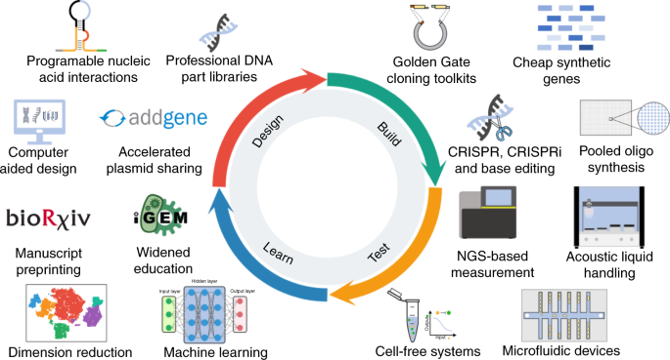
Introduction: Synthetic Biology

Slide 4
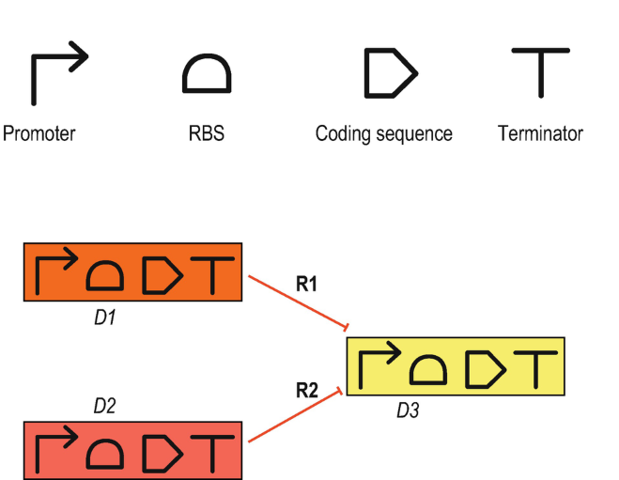
Introduction: Synthetic Biology
Transcription factors
Fluorescent reporters
Enzymes

Slide 5

Introduction: RNA-binding proteins
siRNA
Genetic unit
mRNA transcript
Ribosome
RBP

Slide 6
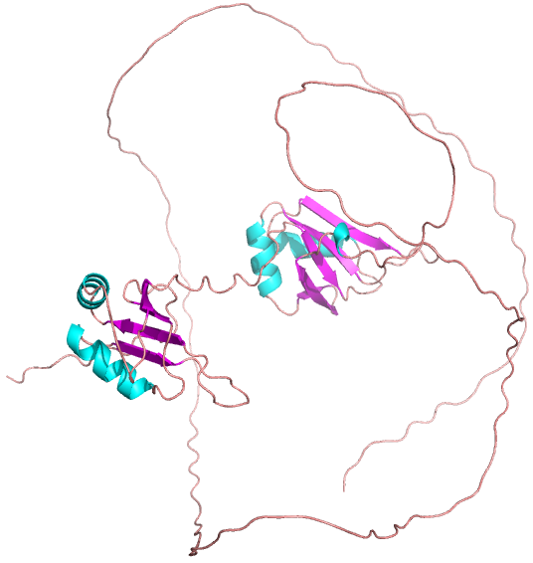
IPTG
eBFP2-MS2CP
sfGFP
LacI
mRNA
DNA
Introduction: the Musashi Family

Slide 7
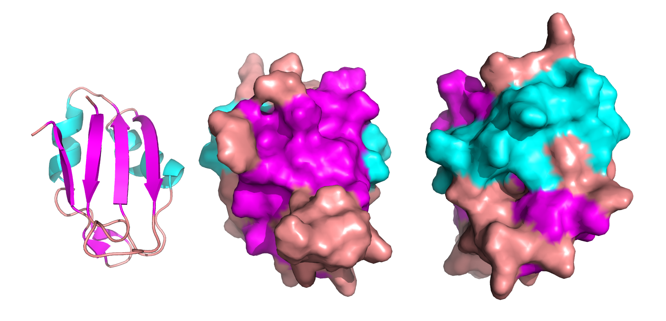
Introduction: the Musashi Family

Slide 8
Objective
Extending the knowledge behind the allosteric interactions occurring in the MSI-1 proteins via docking simulations
Generate the 3D structures of 5 mutant MSI-1 RNA-binding motifs
Protein-RNA docking
Protein-lipid docking
Asses the lipid-protein-RNA complex structure

Slide 9
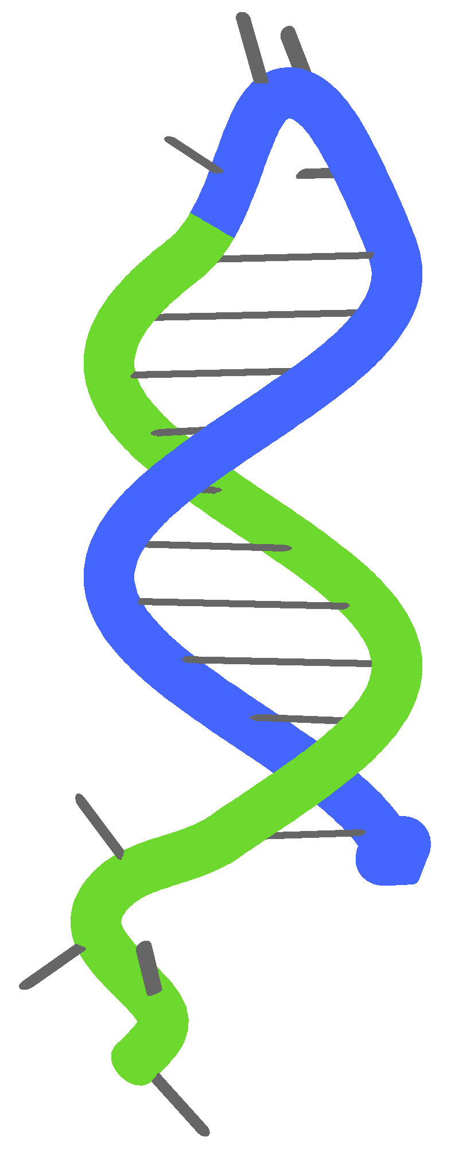
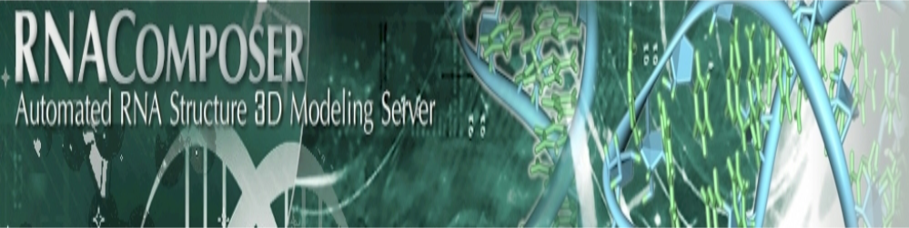

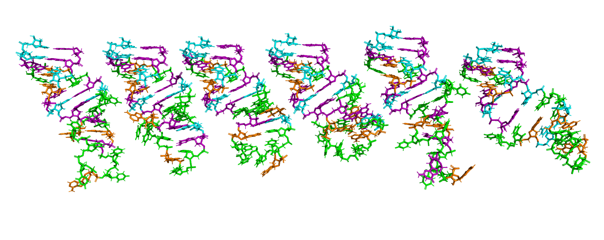
Generation of 3D RNA molecule structures

Slide 10


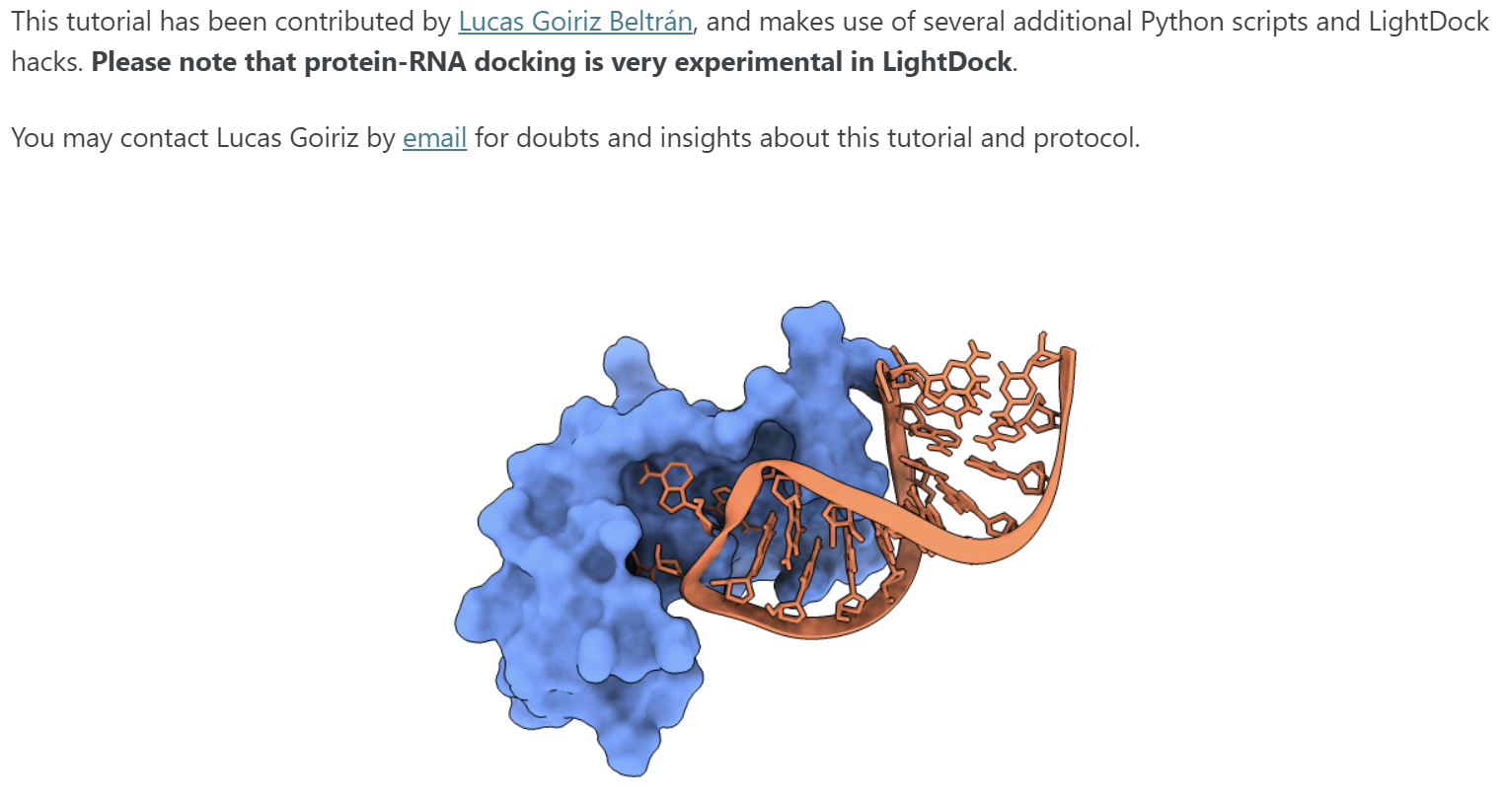
Protein-RNA docking with LightDock

Slide 11
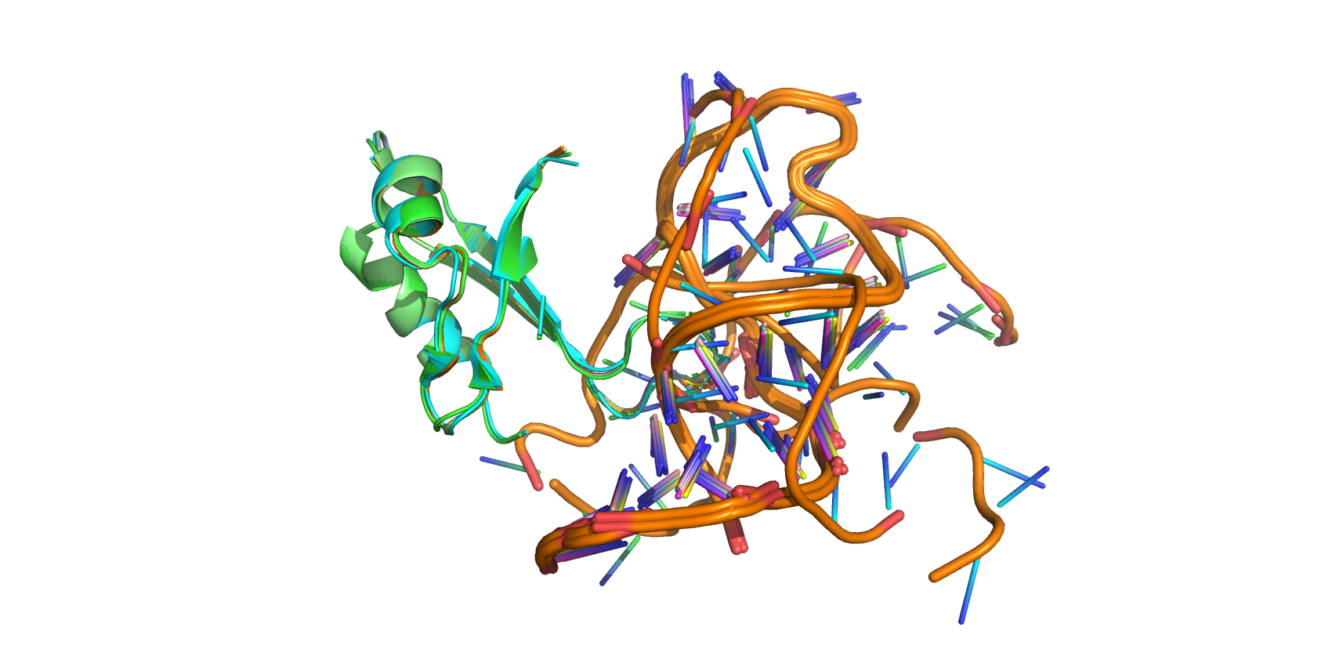
Protein-RNA docking with LightDock
Notes:
The objective of this work is the generation of a DNA circuit design algorithm with the following characteristics:
-It automatically designs a DNA circuit based on a single sequence input
-Avoids signal leak
-Performs a robust miRNA detection

Slide 12
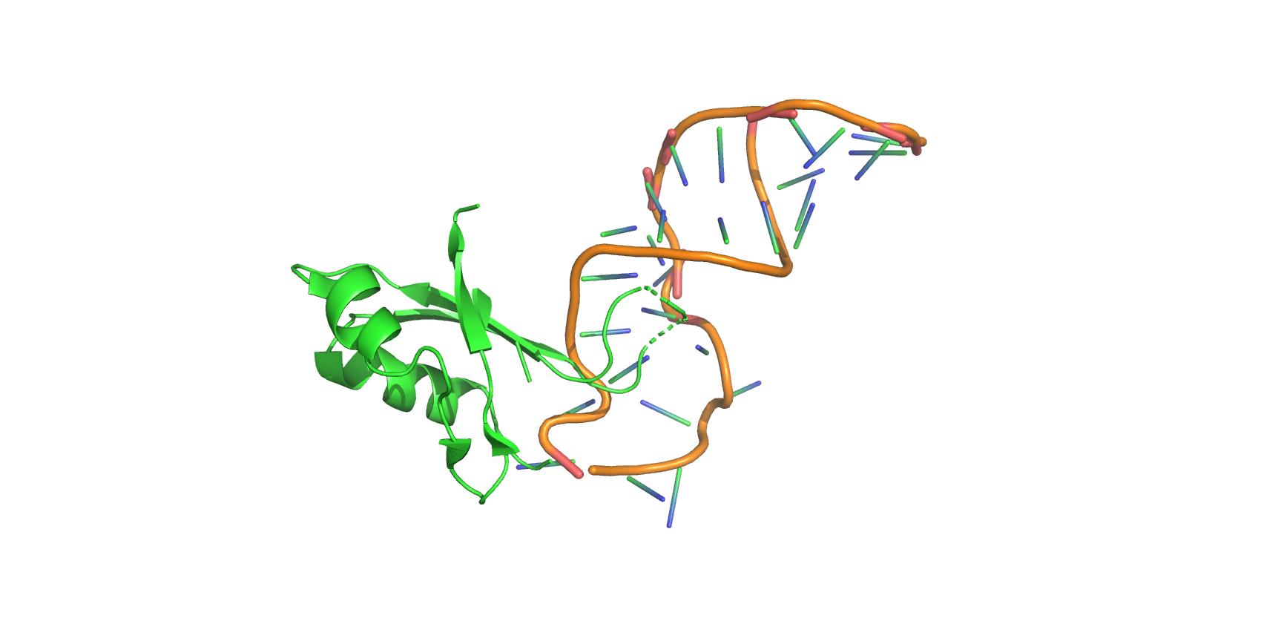
Protein-RNA docking with LightDock
Notes:
The objective of this work is the generation of a DNA circuit design algorithm with the following characteristics:
-It automatically designs a DNA circuit based on a single sequence input
-Avoids signal leak
-Performs a robust miRNA detection

Slide 13
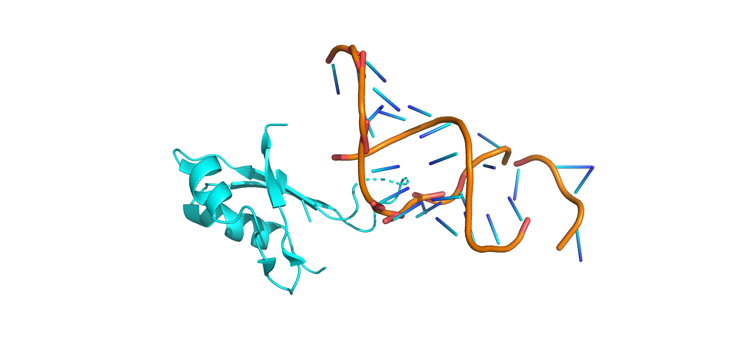
Protein-RNA docking with LightDock
Notes:
The objective of this work is the generation of a DNA circuit design algorithm with the following characteristics:
-It automatically designs a DNA circuit based on a single sequence input
-Avoids signal leak
-Performs a robust miRNA detection

Slide 14
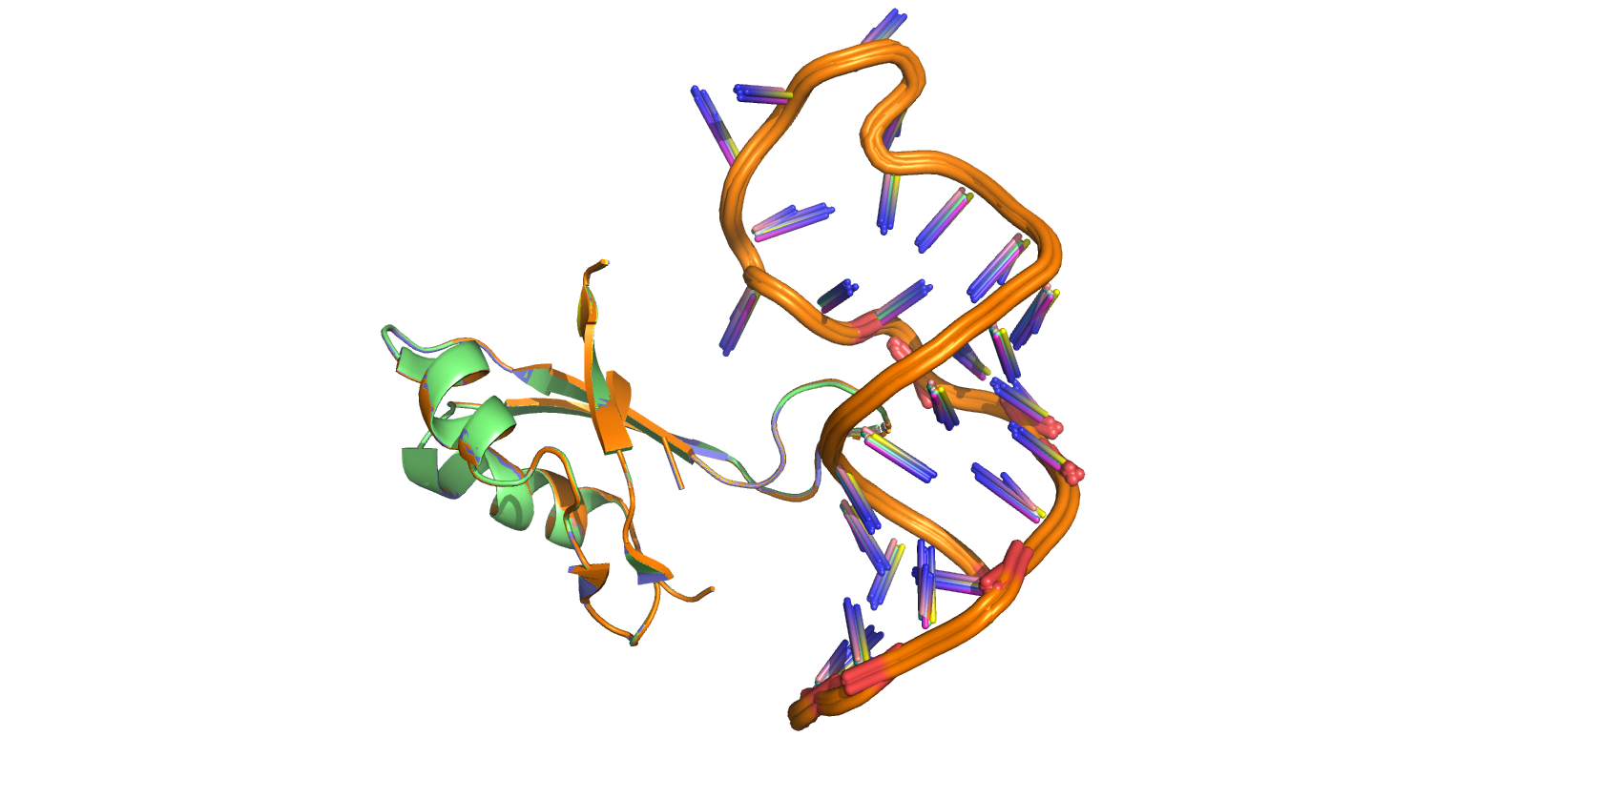
Protein-RNA docking with LightDock
Notes:
The objective of this work is the generation of a DNA circuit design algorithm with the following characteristics:
-It automatically designs a DNA circuit based on a single sequence input
-Avoids signal leak
-Performs a robust miRNA detection

Slide 15
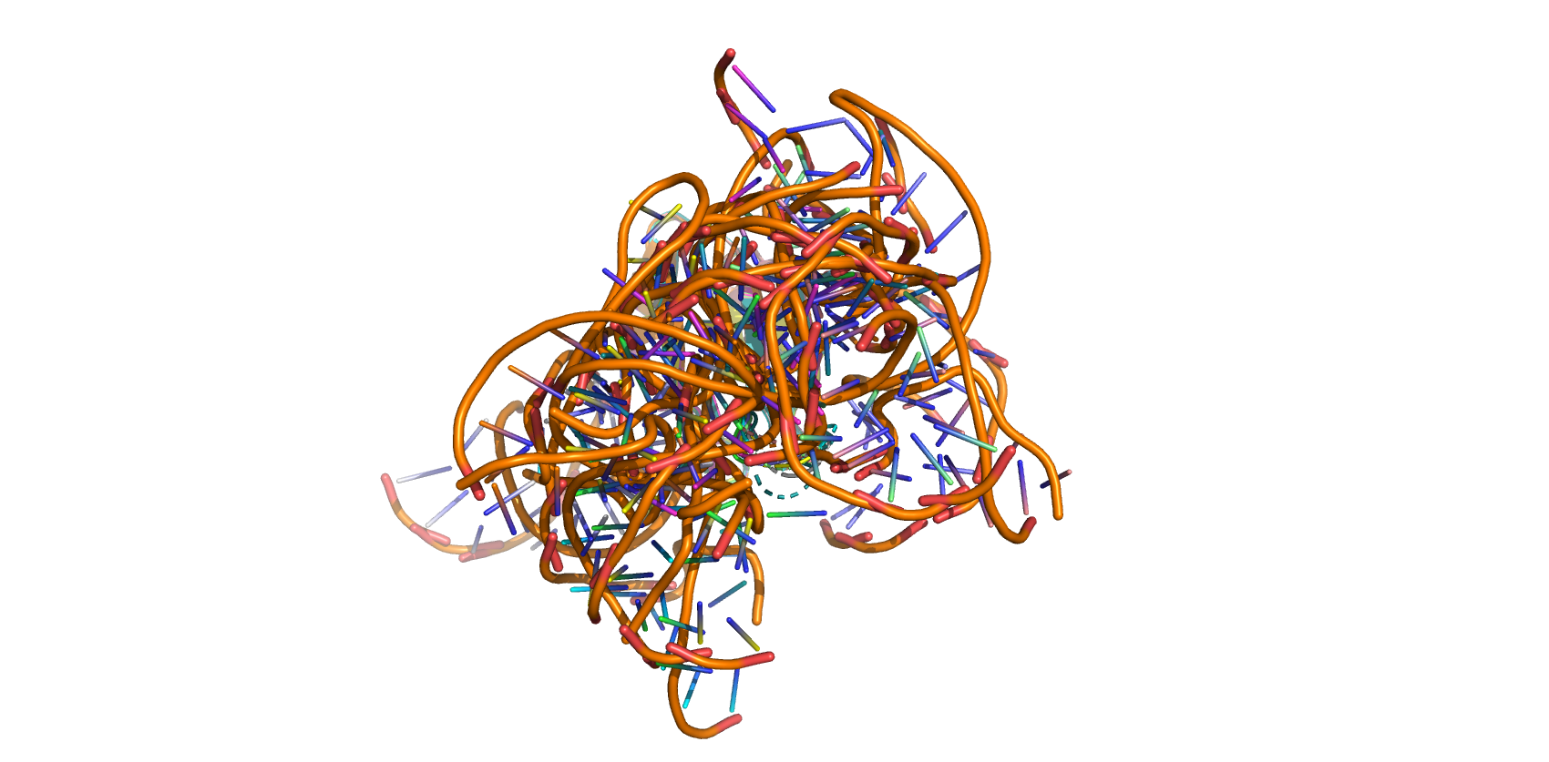
Protein-RNA docking with LightDock
Notes:
The objective of this work is the generation of a DNA circuit design algorithm with the following characteristics:
-It automatically designs a DNA circuit based on a single sequence input
-Avoids signal leak
-Performs a robust miRNA detection

Slide 16
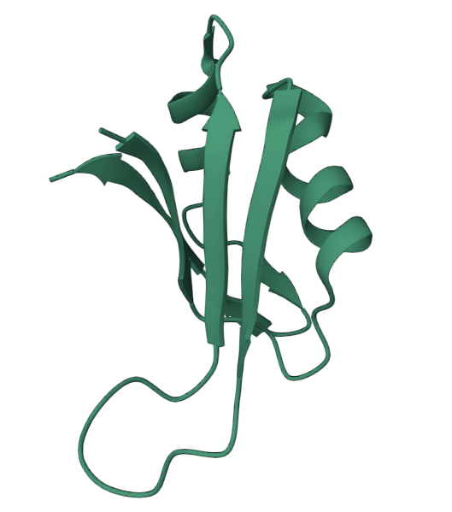
Protein-RNA docking with LightDock
3 satisfactory conformations found for original RNA sequence
Interaction strongly depends on DPLTKRS loop in RRM1
0 satisfactory models found for RNA mutants. Ab initio docking is not enough
Notes:
The objective of this work is the generation of a DNA circuit design algorithm with the following characteristics:
-It automatically designs a DNA circuit based on a single sequence input
-Avoids signal leak
-Performs a robust miRNA detection

Slide 17

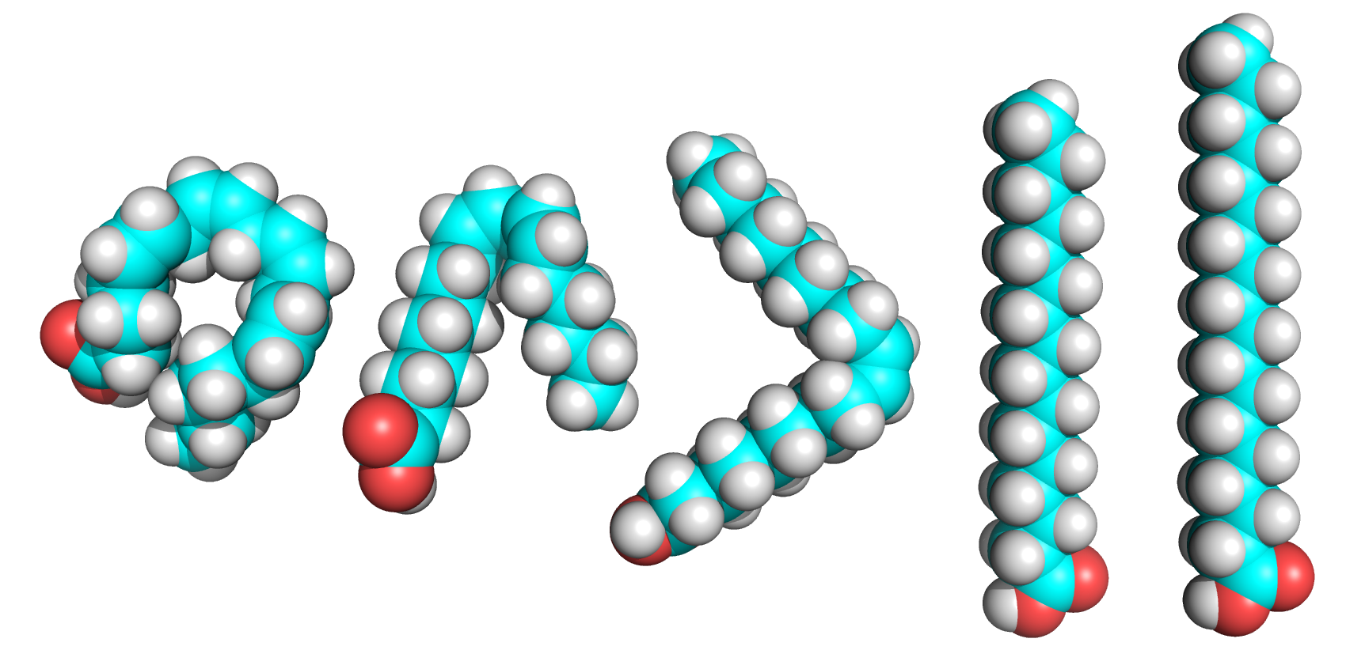
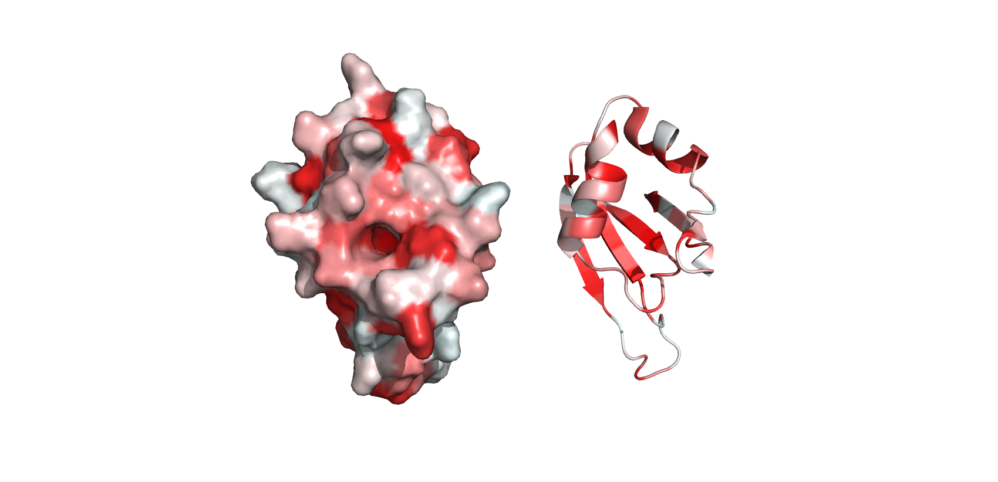
Protein-lipid docking with AutoDockVina
Notes:
The objective of this work is the generation of a DNA circuit design algorithm with the following characteristics:
-It automatically designs a DNA circuit based on a single sequence input
-Avoids signal leak
-Performs a robust miRNA detection

Slide 18
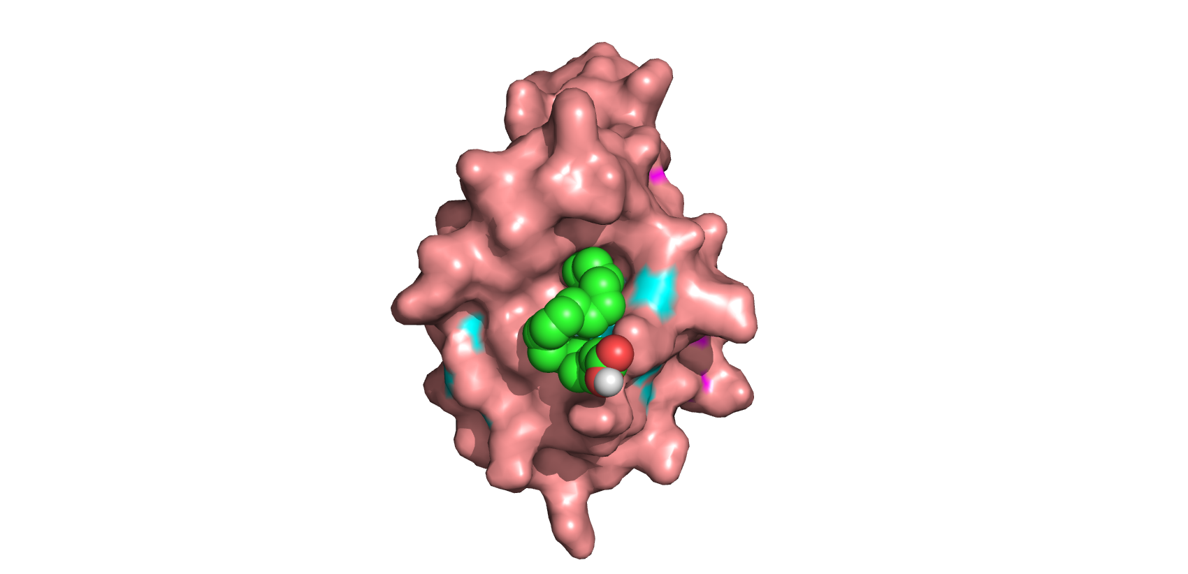
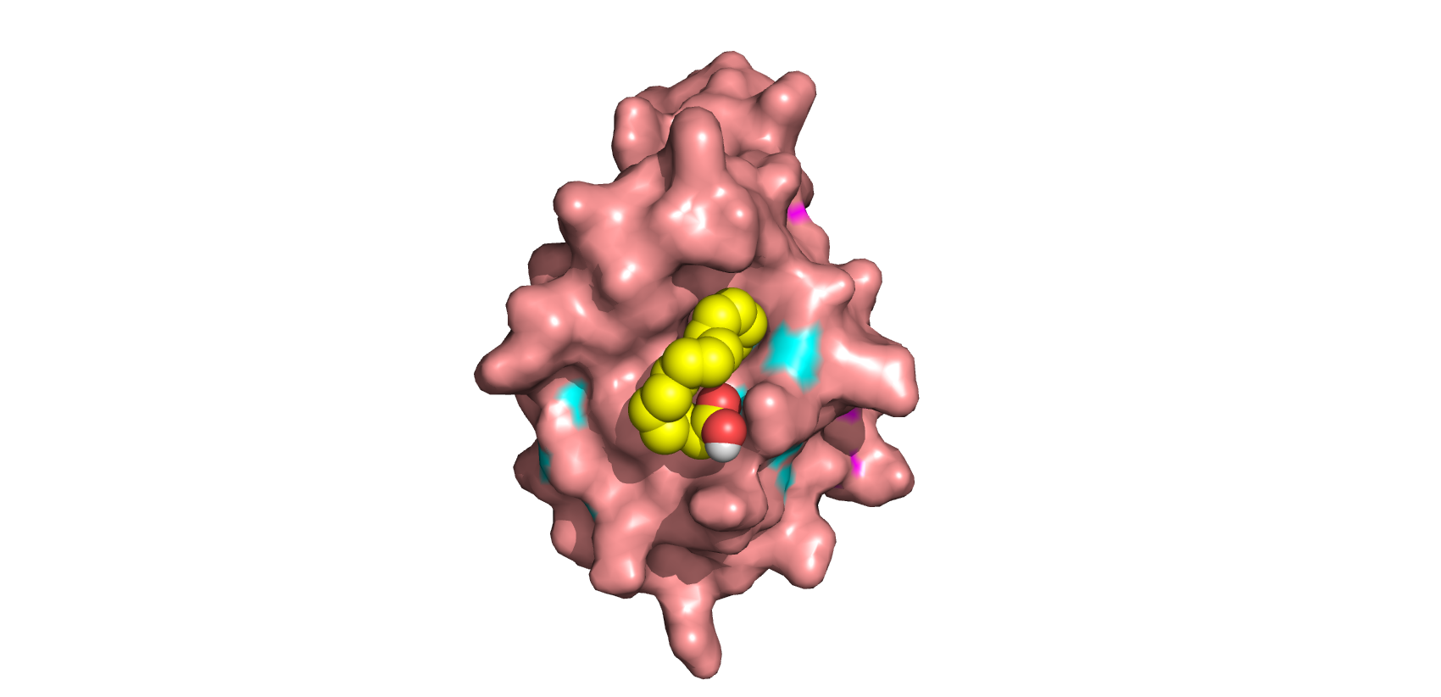
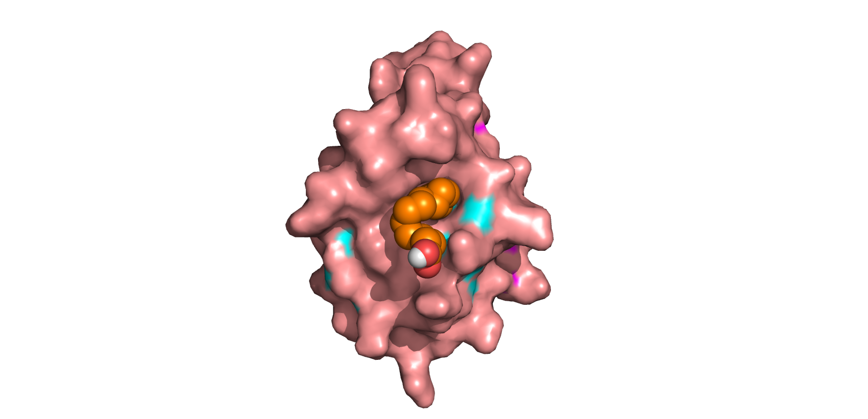
Protein-lipid docking with AutoDockVina
Notes:
The objective of this work is the generation of a DNA circuit design algorithm with the following characteristics:
-It automatically designs a DNA circuit based on a single sequence input
-Avoids signal leak
-Performs a robust miRNA detection

Slide 19
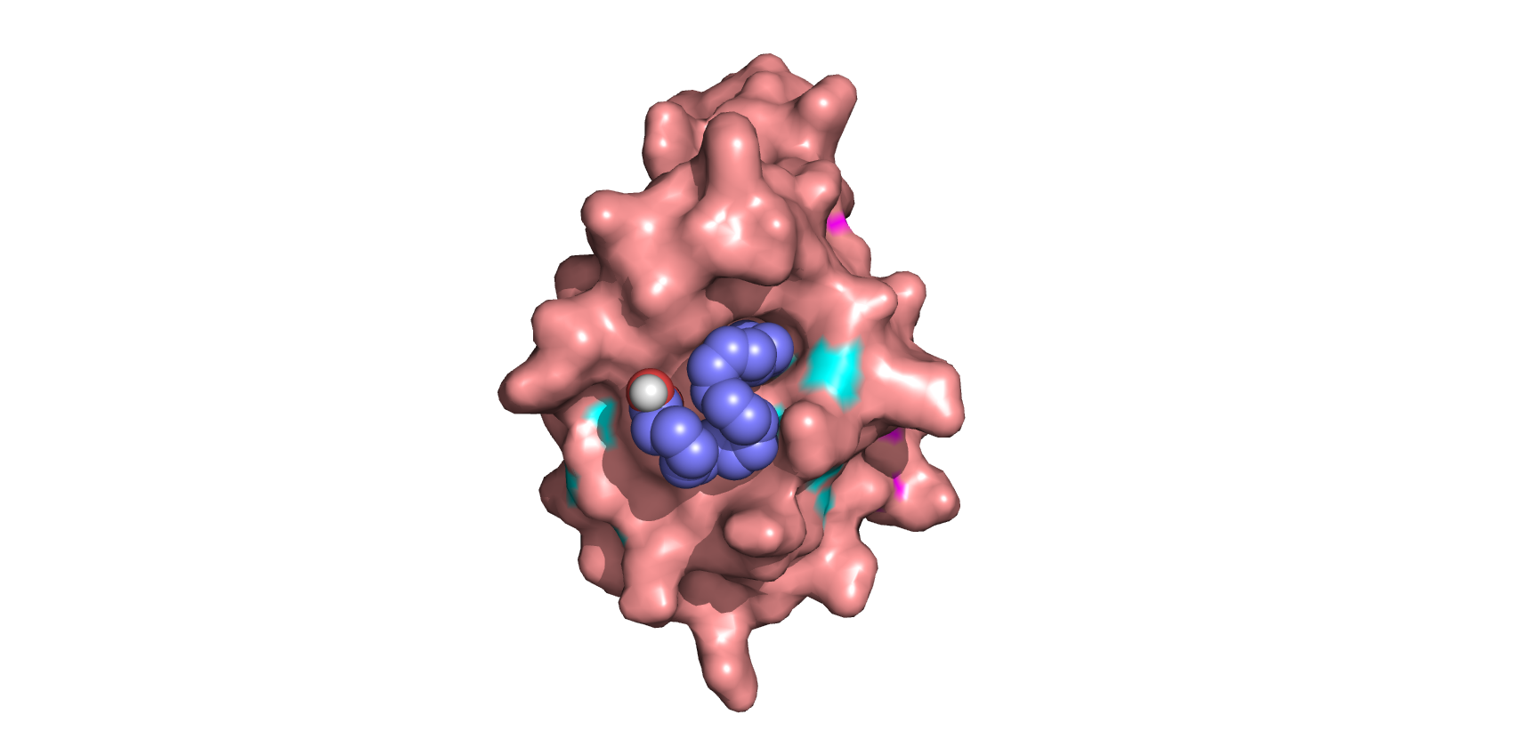
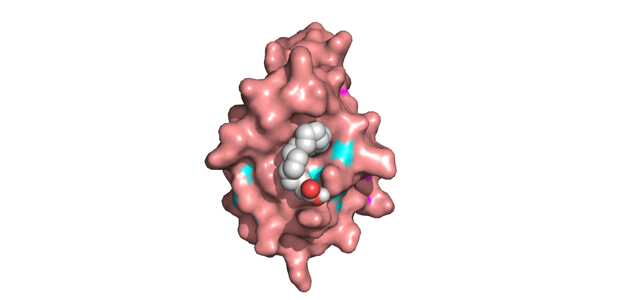
Protein-lipid docking with AutoDockVina
Notes:
The objective of this work is the generation of a DNA circuit design algorithm with the following characteristics:
-It automatically designs a DNA circuit based on a single sequence input
-Avoids signal leak
-Performs a robust miRNA detection

Slide 20
Protein-lipid docking with AutoDockVina
Satisfactory models are generated: hydrophobic chain enters the pocket
Larger and rigid fatty acids have more constrained interactions
Notes:
The objective of this work is the generation of a DNA circuit design algorithm with the following characteristics:
-It automatically designs a DNA circuit based on a single sequence input
-Avoids signal leak
-Performs a robust miRNA detection

Slide 21
Interaction Complexes
Simultaneous docking in LightDock is not possible
Combination of models obtained by LightDock and AutoDockVina
Notes:
The objective of this work is the generation of a DNA circuit design algorithm with the following characteristics:
-It automatically designs a DNA circuit based on a single sequence input
-Avoids signal leak
-Performs a robust miRNA detection

Slide 22
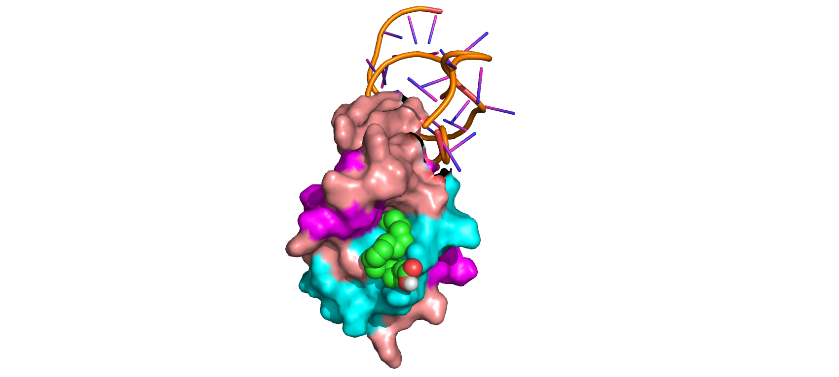
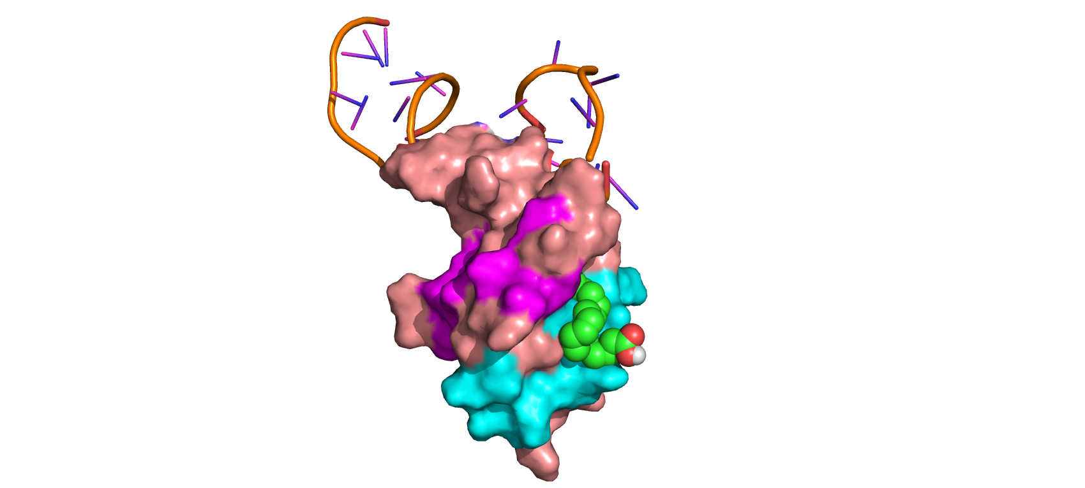
Interaction Complexes
90º
Notes:
The objective of this work is the generation of a DNA circuit design algorithm with the following characteristics:
-It automatically designs a DNA circuit based on a single sequence input
-Avoids signal leak
-Performs a robust miRNA detection

Slide 23
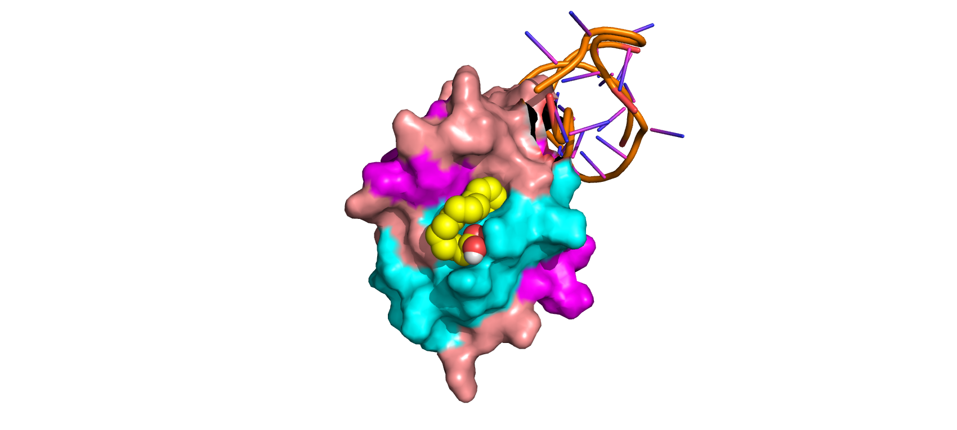
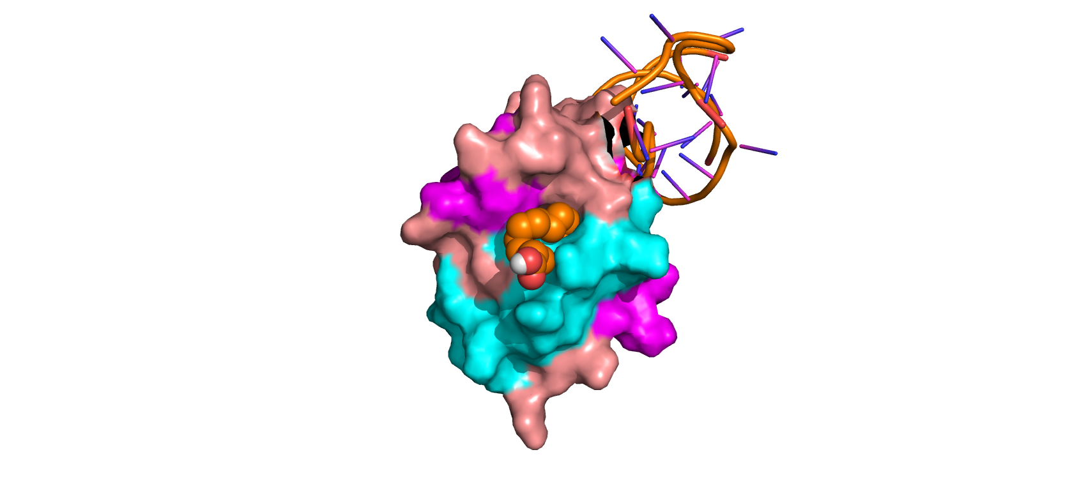
Interaction Complexes
Notes:
The objective of this work is the generation of a DNA circuit design algorithm with the following characteristics:
-It automatically designs a DNA circuit based on a single sequence input
-Avoids signal leak
-Performs a robust miRNA detection

Slide 24
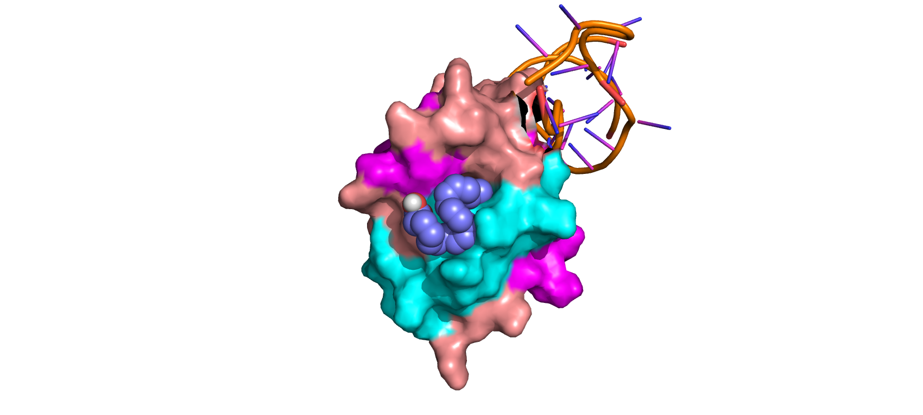
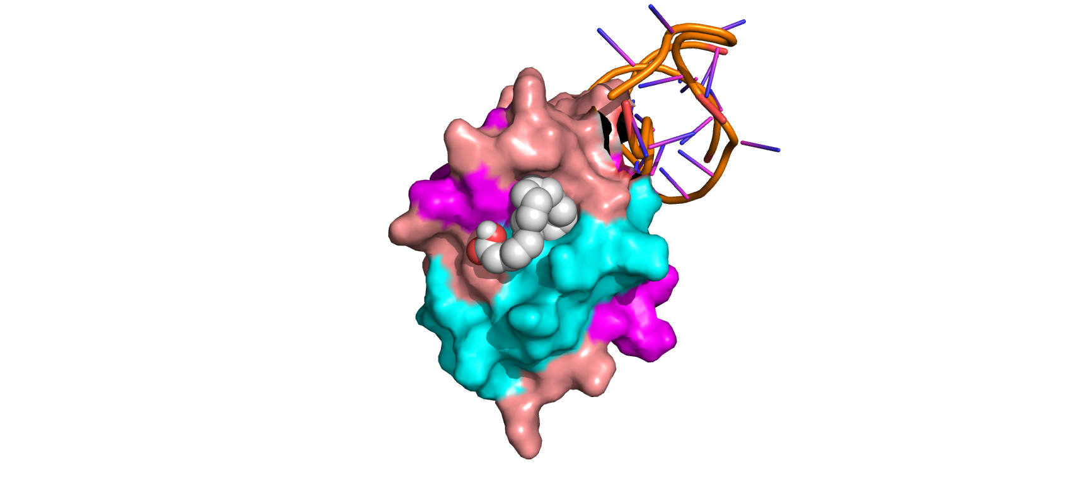
Interaction Complexes
Notes:
The objective of this work is the generation of a DNA circuit design algorithm with the following characteristics:
-It automatically designs a DNA circuit based on a single sequence input
-Avoids signal leak
-Performs a robust miRNA detection

Slide 25
Conclusions
Allosteric behavior riginates from a conformational change within RRM1
Fatty acid size and flexibility can be the direct origin of conformational changes
Further work with Molecular dynamics is necessary
Notes:
The objective of this work is the generation of a DNA circuit design algorithm with the following characteristics:
-It automatically designs a DNA circuit based on a single sequence input
-Avoids signal leak
-Performs a robust miRNA detection

Slide 26


Acknowledgements
Dr. Emmanuel Fajardo (UOC)
Staff from the BioSystems Design Team (I2SysBio - CSIC):
Dr. Raúl Ruiz
Dra. Roser Montagud
María Heras
“The clinical research teams that will be most successful in the coming decades will be those that can switch effortlessly between the laboratory bench, clinical practice, and the use of these sophisticated computational tools”
-Ardeshir Bayat; Science, medicine, and the future: Bioinformatics (2002)

Slide 27
Docking assays of Musashi-1 allosteric RNA-binding sites
Author: Lucas Goiriz Beltrán (UPV - CSIC)
Supervisor: Dr. Emmanuel Fajardo (UOC)
January 2023

